Slide 1

Biot-Savart Law
Theory and Mathematical Problem Solving
Group A Team Ampere Members-
Sinthia Rahman [232-15-525]
Sayma Islam Nipa [232-15-511]
Sourov Das [232-15-496]
Supan Roy [232-15-716]
Sanzida Akter Nupur [232-15-759]
Md. Mahmudul Hasan Ashik [0242310005101731]

Slide 2
Biot-Savart Law
Theory and Mathematical Problem Solving
Presented To-
MR. ABDULLAH AL SAKIB
Lecturer of Physics
Department of Computer Science and Engineering
Daffodil International University.

Slide 3
CONTENTS
Introduction
Biot-Savart Law Discussion
History and Applications of BSL
Problem Solving using BSL
Understandings and Uses of BSL
Contribution

Slide 4
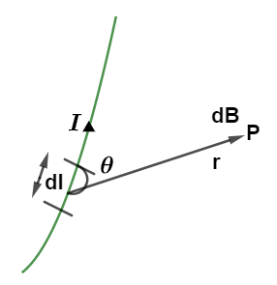
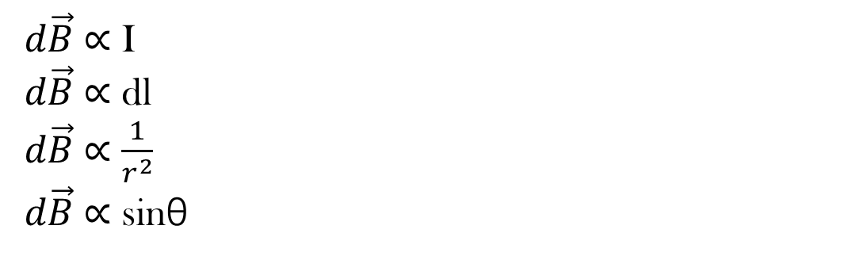
INTRODUCTION
Biot-Savart Law
Biot Savart Law states that, The magnetic field of a point for a long wire is directly proportional to the current, length of the conductor, inversely proportional to the square of the distance between the wire and the point, and proportional to the sin angle between them.
𝑑$\vec{B}$ ∝ I
𝑑$\vec{B}$ ∝ dl
𝑑$\vec{B}$ ∝ $\frac{1}{r^{2}}$
𝑑$\vec{B}$ ∝ sinθ

Slide 5
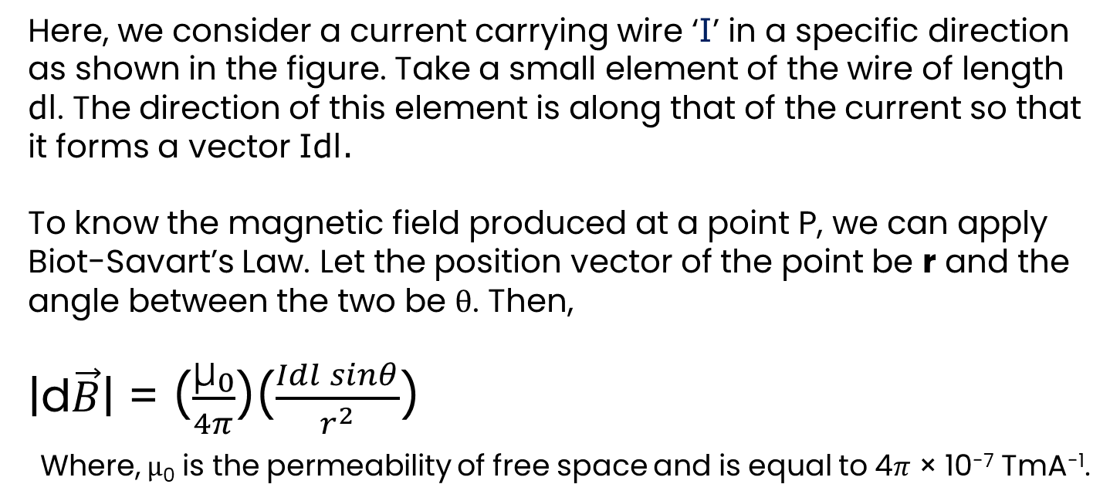
INTRODUCTION
What is the Formula of Biot-Savart’s Law?
Here, we consider a current carrying wire ‘I’ in a specific direction as shown in the figure. Take a small element of the wire of length dl. The direction of this element is along that of the current so that it forms a vector Idl.
To know the magnetic field produced at a point P, we can apply Biot-Savart’s Law. Let the position vector of the point be r and the angle between the two be θ. Then,
|d$\vec{B}$| = ($\frac{\text{μ}\text{₀}}{4π}$)($\frac{Idl sinθ}{r^{2}}$)
Where, μ₀ is the permeability of free space and is equal to 4$π$ × 10⁻⁷ TmA⁻¹.

Slide 6
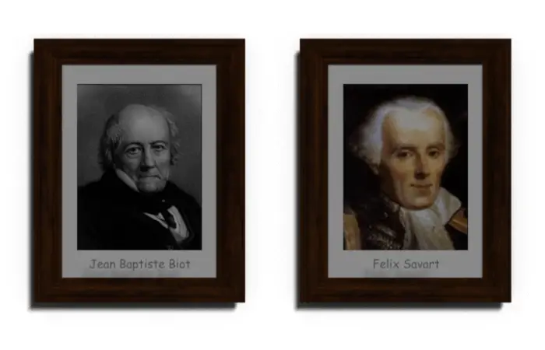
HISTORY
History of Biot-Savart Law
In 1820, French physicists Jean-Baptiste Biot and Félix Savart began investigating the magnetic field produced by a current-carrying conductor. They conducted experiments to measure the magnetic force exerted by such conductors.
Biot and Savart observed that the magnetic field around a current-carrying wire could be described by a mathematical formula. Through their experiments, they derived what is now known as the Biot-Savart Law.

Slide 7
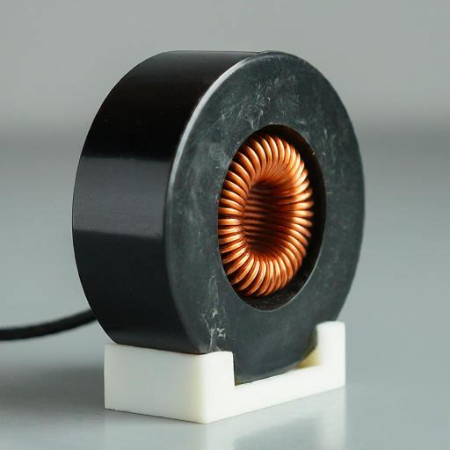
Real Life Applications of BSL
Applications of Biot-Savart’s Law
The Biot-Savart Law, named after French physicists Biot and Savart, isn't just a theory in textbooks. It's important in various parts of our daily lives, like powering our homes and shaping technological advancements. This presentation will explore the practical significance and diverse applications of this fundamental law in electromagnetism.

Slide 8
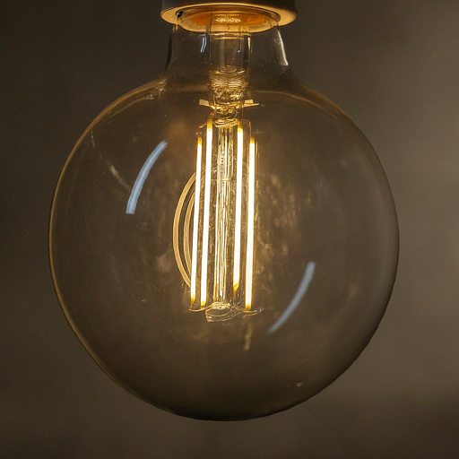
Real Life Applications of BSL
Applications of Biot-Savart’s Law
Everyday items such as lightbulbs and motors use the principles of the Biot-Savart Law. When electricity flows through the filament or coils, it creates a magnetic field that interacts with charged particles, resulting in the production of light, motion, or sound.

Slide 9
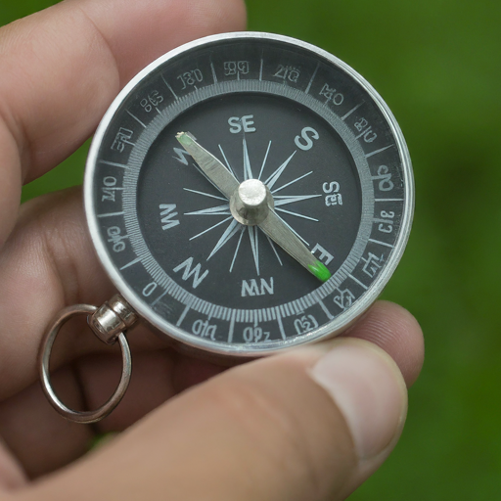
Real Life Applications of BSL
Applications of Biot-Savart’s Law
The Biot-Savart Law doesn't just apply to human-made inventions. It also affects Earth's magnetic field, which guides compasses and shields us from harmful solar radiation. Scientists also use its principles to study the magnetic fields of stars and galaxies, helping with astrophysical research.

Slide 10
Mathematical Problem 1
Determining magnitude and direction of the net magnetic field at a point

Slide 11
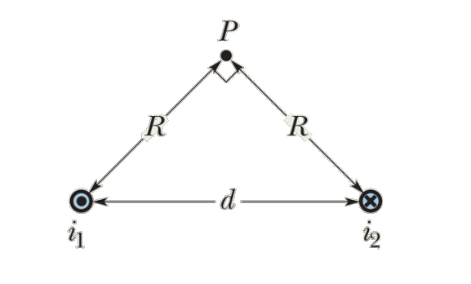
Problem 1
Figure shows two long parallel wires carrying currents i₁ and i₂ in opposite directions. What are the magnitude and direction of the net magnetic field at point P? Assume the following values: i₁ = 15 A, i₂ = 32 A, and d = 5.3 cm.

Slide 12


Solution
Q1: Figure shows two long parallel wires carrying currents i₁ and i₂ in opposite directions. What are the magnitude and direction of the net magnetic field at point P? Assume the following values: i₁ = 15 A, i₂ = 32 A, and d = 5.3 cm.
At first we measure the distance of point P from each wire.
As △ Pi₁i₂ is a Isosceles triangle, so -
Distance R = $\frac{d}{2 cosθ}$ = $\frac{d}{2 cos45⁰}$ = 3.75cm = 3.75$×{10}^{−2}$m
The magnetic field at point P due to current i₁ is –
B₁ = $\frac{\text{μ}\text{₀}\text{i}\text{1}}{2 πR}$
= $\frac{4π×{10}^{−7}×15}{2π(3.75×{10}^{−2})}$
= 8× ${10}^{−5}$T
Here, $\text{μ}\text{₀}$ = $4π×{10}^{−7}\text{TmA}\text{−1}$
i₁ = 15 A
R = 3.75$×{10}^{−2}$m

Slide 13


Solution
Q1: Figure shows two long parallel wires carrying currents i₁ and i₂ in opposite directions. What are the magnitude and direction of the net magnetic field at point P? Assume the following values: i₁ = 15 A, i₂ = 32 A, and d = 5.3 cm.
Similarly, The magnetic field at point P due to current i₂ is –
B₂ = $\frac{\text{μ}\text{₀}\text{i}\text{2}}{2 πR}$
= $\frac{4π×{10}^{−7}×32}{2π(3.75×{10}^{−2})}$
= 1.71× ${10}^{−4}$T
Here, $\text{μ}\text{₀}$ = $4π×{10}^{−7}\text{TmA}\text{−1}$
i₂ = 32 A
R = 3.75$×{10}^{−2}$m

Slide 14
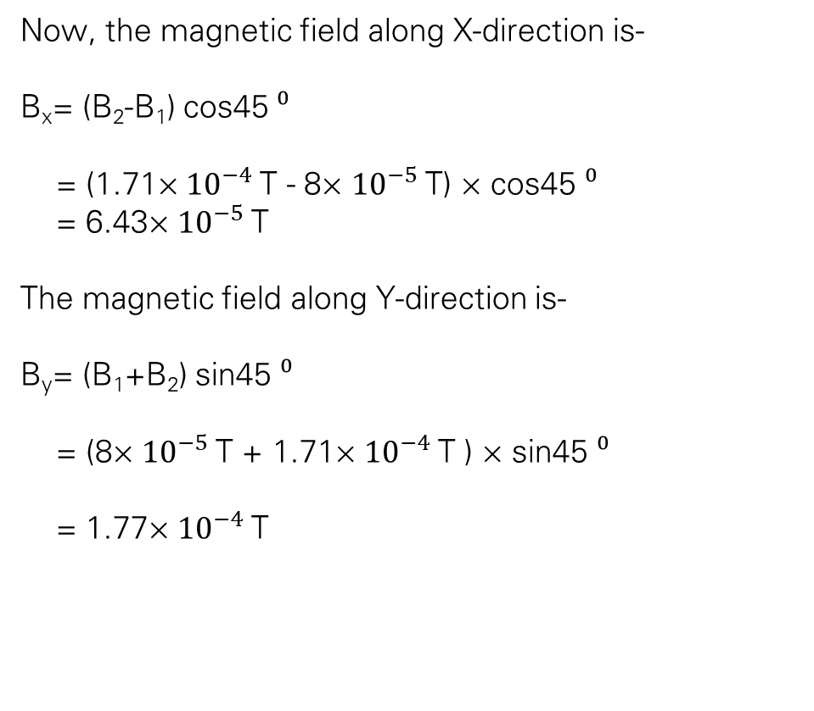
Solution
Q1: Figure shows two long parallel wires carrying currents i₁ and i₂ in opposite directions. What are the magnitude and direction of the net magnetic field at point P? Assume the following values: i₁ = 15 A, i₂ = 32 A, and d = 5.3 cm.
Now, the magnetic field along X-direction is-
B_{x}= (B₂-B₁) cos45 $⁰$
= (1.71× ${10}^{−4}$T - 8× ${10}^{−5}$T) × cos45 $⁰$
= 6.43× ${10}^{−5}$T
The magnetic field along Y-direction is-
B_{y}= (B₁+B₂) sin45 $⁰$
= (8× ${10}^{−5}$T + 1.71× ${10}^{−4}$T ) × sin45 $⁰$
= 1.77× ${10}^{−4}$T

Slide 15

Solution
Q1: Figure shows two long parallel wires carrying currents i₁ and i₂ in opposite directions. What are the magnitude and direction of the net magnetic field at point P? Assume the following values: i₁ = 15 A, i₂ = 32 A, and d = 5.3 cm.
The magnitude of net magnetic field is
B = $\sqrt{B\text{x}\text{2}\text{ + }\text{By}\text{2}}$
= $\sqrt{\text{(6.43×} {10}^{−5}\text{)}\text{2}\text{+(1.77×} {10}^{−4}\text{)}\text{2} }$
= 1.88 $\text{×} {10}^{−4}$ T
And the direction is –
$∅=tan$⁻¹($\frac{By}{Bx})$
= $tan$⁻¹ $\frac{\text{1.77×}\text{10}\text{−4}}{\text{6.43×10}\text{−}5}$
= 70.04$°$

Slide 16
Understandings
"In this problem, we investigated the magnetic field generated by two long parallel wires carrying currents in opposite directions. By applying the principles of the Biot-Savart Law and understanding the right-hand rule for determining the direction of magnetic fields around current-carrying wires, we were able to calculate the magnitude and direction of the net magnetic field at a specific point, P. This exercise helped us understand better how electric currents and magnetic fields interact, which are important ideas in electromagnetism."

Slide 17
Uses of this Problem
Electrical Engineering: Understanding the magnetic fields generated by current-carrying wires is crucial in designing electrical circuits and devices such as transformers, motors, and generators.
Medical Imaging: Techniques like Magnetic Resonance Imaging (MRI) rely on the principles of electromagnetism to produce detailed images of internal body structures, aiding in diagnosis and treatment planning.
Power Distribution: Calculating magnetic fields helps optimize the design and efficiency of power distribution systems, ensuring reliable electricity supply to homes and industries.

Slide 18
Uses of this Problem
Navigation Systems: Magnetic field calculations are essential for the functioning of compasses and navigation systems, aiding in accurate orientation and navigation on land, sea, and air.
Astrophysics: Understanding magnetic fields is vital in studying celestial bodies such as stars, planets, and galaxies, providing insights into their formation, behavior, and evolution.

Slide 19
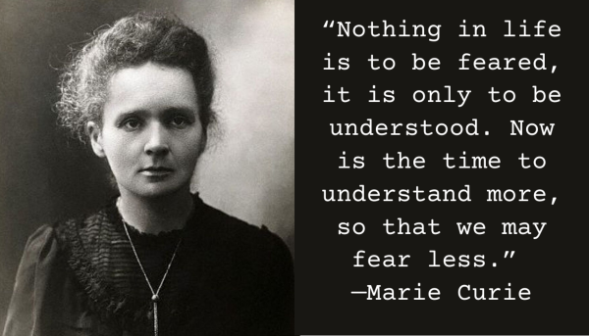
QUOTE

Slide 20
Contribution

Slide 21


